Slide 1

INTELLIGENT PROCESS SCHEDULER FOR SMART MANUFACTURING SYSTEMS
CSA0405- Operating Systems
Guided By
Dr J PRISKILLA ANGEL RANI
Presented By
Atchaya Chandran R(192521394)
Sakthivel K(192521484)
Hari Haran P(192521335)
Teja Vardhan Reddy E(192425297)
Abhirama Krishna P(192472037)

Slide 2



Introduction
Smart manufacturing uses technologies such as Artificial Intelligence (AI), IoT, and automation to improve production efficiency and product quality.
An Intelligent Process Scheduler automatically assigns and manages manufacturing tasks based on machine availability, resource usage, and production priorities.
The scheduler can respond to real-time changes, such as machine breakdowns, urgent customer orders, or material shortages, ensuring smooth production.
This system improves productivity, reduces production delays and costs, and supports Industry 4.0 by enabling efficient and intelligent manufacturing operations.
An intelligent scheduling system helps balance workloads across machines and workers, reducing idle time and ensuring timely completion of manufacturing processes.

Slide 3
Problem Statement
Inefficient Job Scheduling – Multiple manufacturing jobs are not always scheduled efficiently.
Excessive Waiting Time – Jobs may spend too much time waiting in the execution queue.
Process Starvation – Some jobs may be delayed for a long time without receiving execution time.
Lack of Real-Time Monitoring – Difficulty in tracking job progress and system status during execution.
Limited Performance Analysis – Lack of proper analysis of scheduling efficiency and resource utilization.

Slide 4
Objectives
Develop an intelligent scheduling system to efficiently manage manufacturing processes.
Implement FCFS scheduling to organize and execute jobs based on their arrival time.
Simulate jobs in real time to monitor process execution and job status.
Detect process starvation by monitoring excessive waiting times.
Generate performance reports to analyze waiting time, turnaround time, and machine utilization.

Slide 5
Technologies Used
Python – Core programming language for scheduling logic and application development.
Streamlit – Used to build the interactive web-based GUI dashboard.
Plotly – Used for interactive charts, execution timelines, machine utilization, CPU load, and performance graphs.
FCFS Algorithm – Used for First-Come, First-Serve process scheduling.
Real-Time Simulation – Used to simulate live job execution and machine status.
Data Visualization – Used to display waiting time, turnaround time, CPU utilization, and machine performance.
Python Date/Time & Simulation Logic – Used for execution timing, process monitoring, and starvation detection.

Slide 6
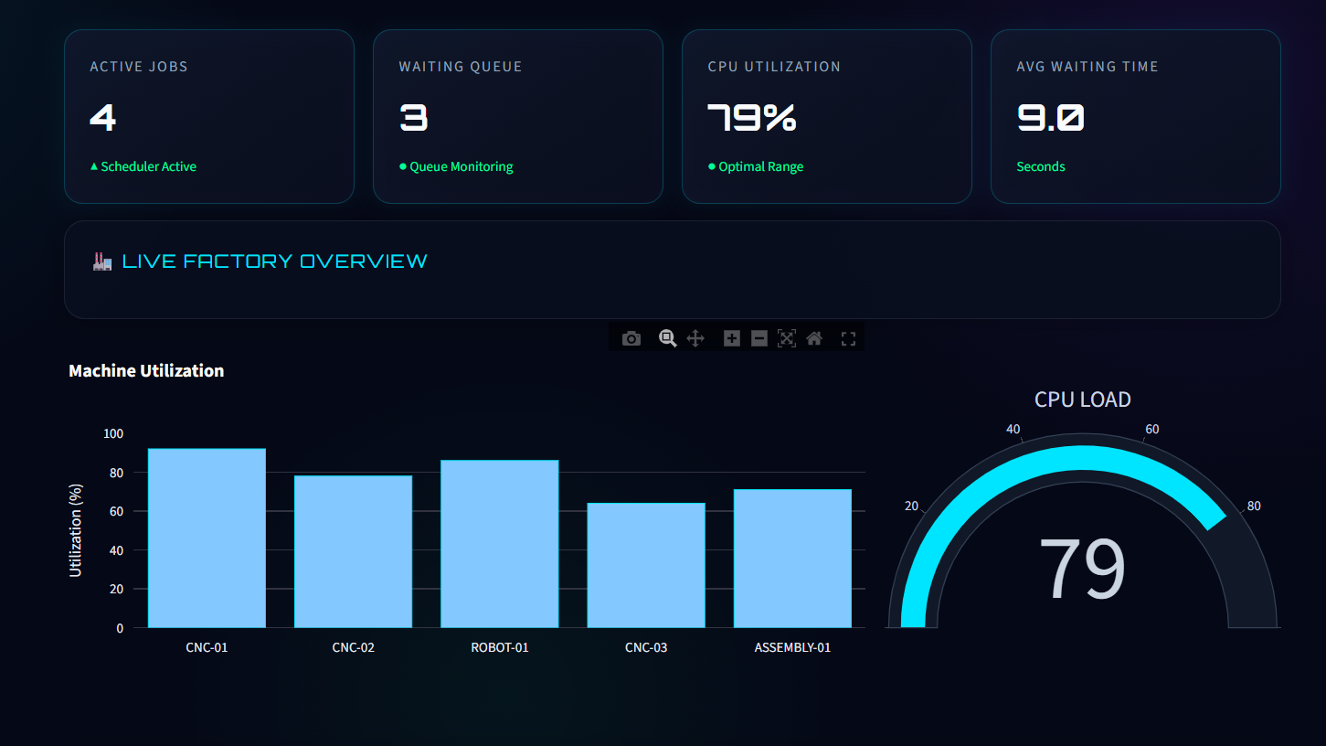
Module 1 – GUI Dashboard
Centralized Job Management – Add, view, update, and manage manufacturing jobs and their scheduling information.
Real-Time Process Monitoring – Display running, waiting, completed, and idle processes with live status updates.
Scheduling Control & Visualization – Provide controls to start, pause, reset scheduling and visualize the job queue and execution process.
Performance & Alert Dashboard – Show waiting time, turnaround time, machine utilization, completed jobs, and starvation alerts.
Smart Manufacturing Overview – Provide a clear real-time overview of production activities, machine status, job progress, and overall system efficiency.

Slide 7
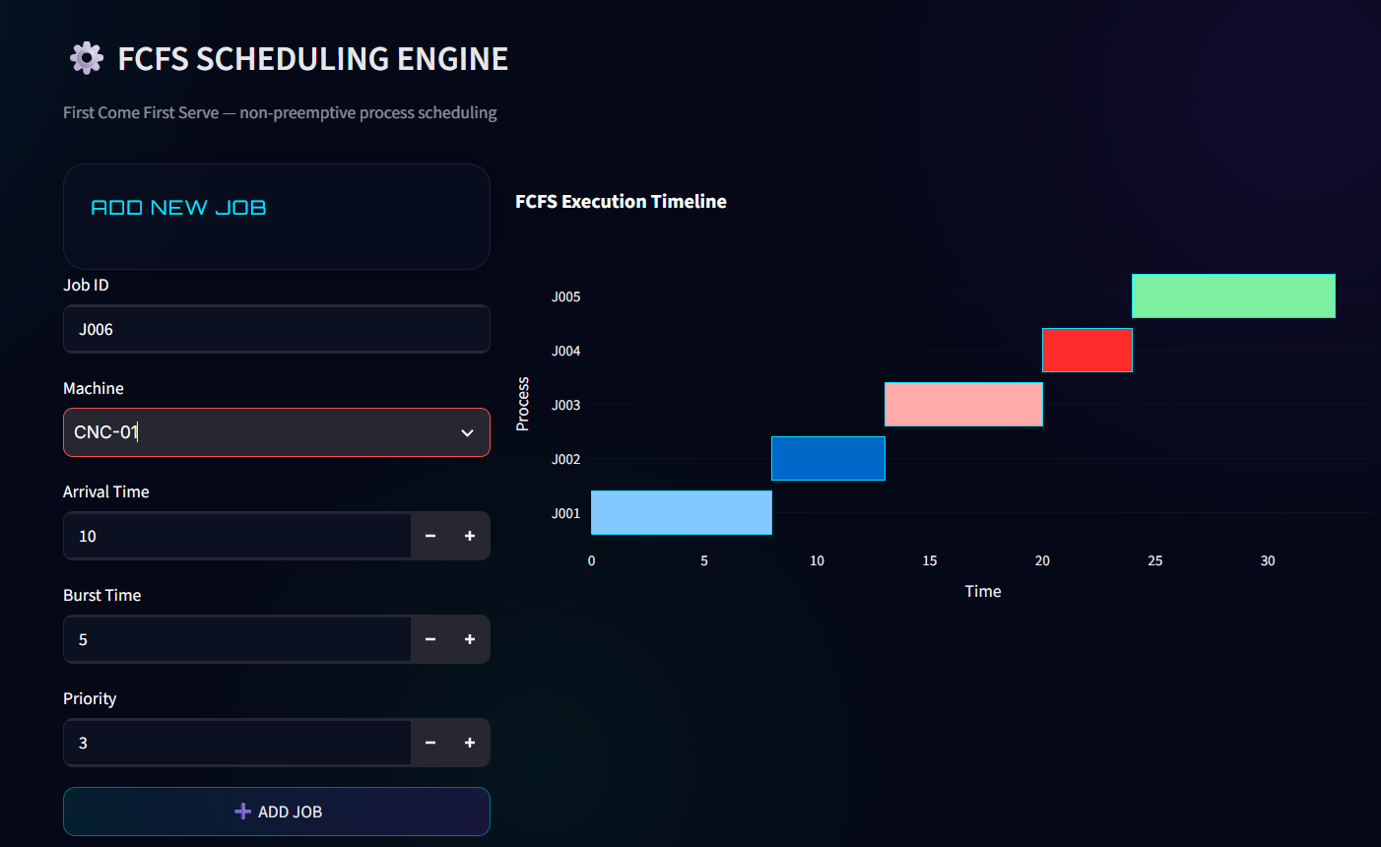
Module 2 – FCFS Scheduling
First-Come, First-Served Execution – Processes are executed in the order they arrive.
Job Queue Management – Maintains an organized queue of manufacturing jobs waiting for execution.
Waiting Time Calculation – Calculates how long each process waits before execution.
Turnaround Time Calculation – Determines the total time taken from process arrival to completion.
Scheduling Performance Analysis – Calculates average waiting time and average turnaround time to evaluate scheduler efficiency.

Slide 8
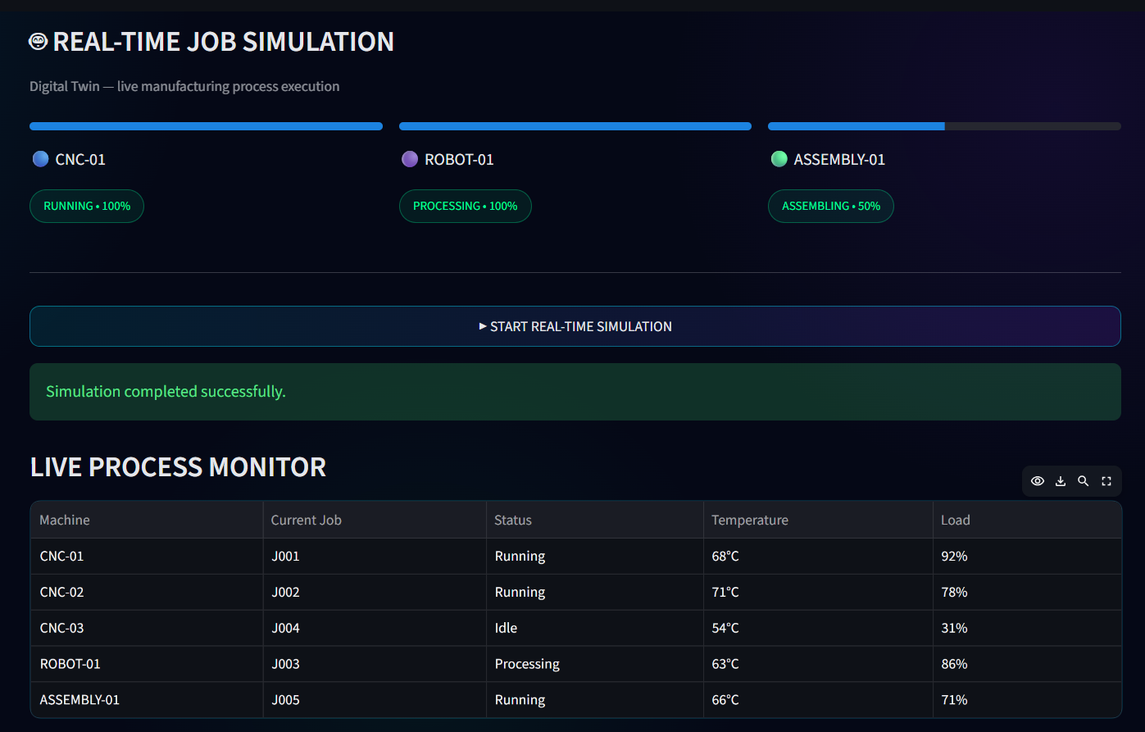
Module 3 – Real-Time Job Simulation
Live Job Execution – Simulates manufacturing jobs being executed in real time.
Process Status Monitoring – Displays jobs as Waiting, Running, and Completed.
Execution Progress Tracking – Shows the real-time progress and remaining execution time of each job.
Dynamic Job Queue – Updates the waiting queue automatically as jobs start and finish.
Real-Time Performance Monitoring – Tracks execution time, completed jobs, and machine utilization during simulation.

Slide 9
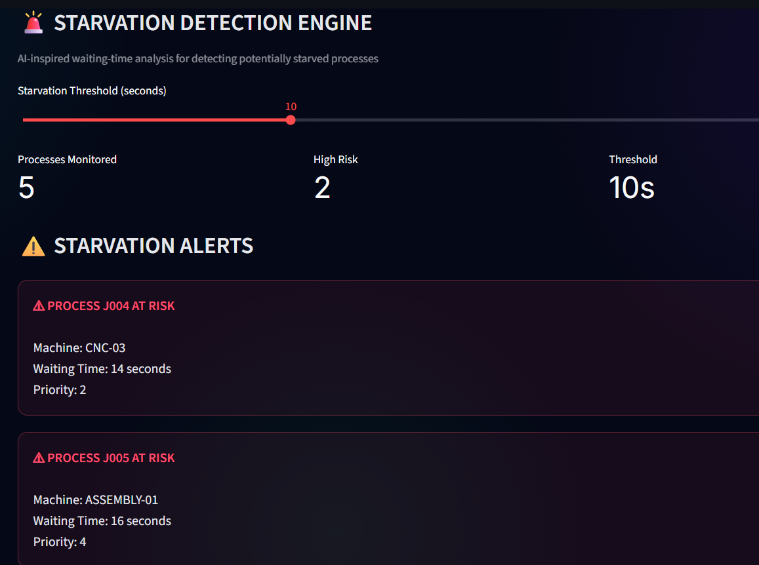
Module 4 – Starvation Detection
Waiting Time Monitoring – Continuously monitors how long each manufacturing job remains in the waiting queue.
Starvation Threshold Detection – Identifies jobs whose waiting time exceeds a predefined threshold.
Early Warning Alerts – Generates alerts when a job is approaching or experiencing starvation.
Priority Risk Identification – Highlights high-risk jobs so they can be given attention before excessive delays occur.
Starvation Analysis & Reporting – Records detected starvation events and provides statistics for performance evaluation.

Slide 10
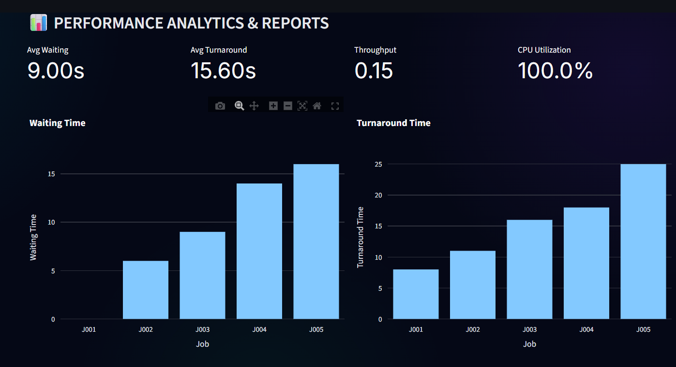
Module5 – Performance Analytics & Reports
Scheduling Performance Calculation – Calculates waiting time, turnaround time, completion time, and response time.
Job Performance Analysis – Evaluates the execution performance of individual manufacturing jobs.
Machine Utilization Monitoring – Measures active and idle machine time to determine overall utilization.
Graphical Performance Visualization – Generates charts for waiting time, turnaround time, job completion, and utilization.
Automated Report Generation – Produces a final performance report containing scheduling results, statistics, and detected starvation events.

Slide 11
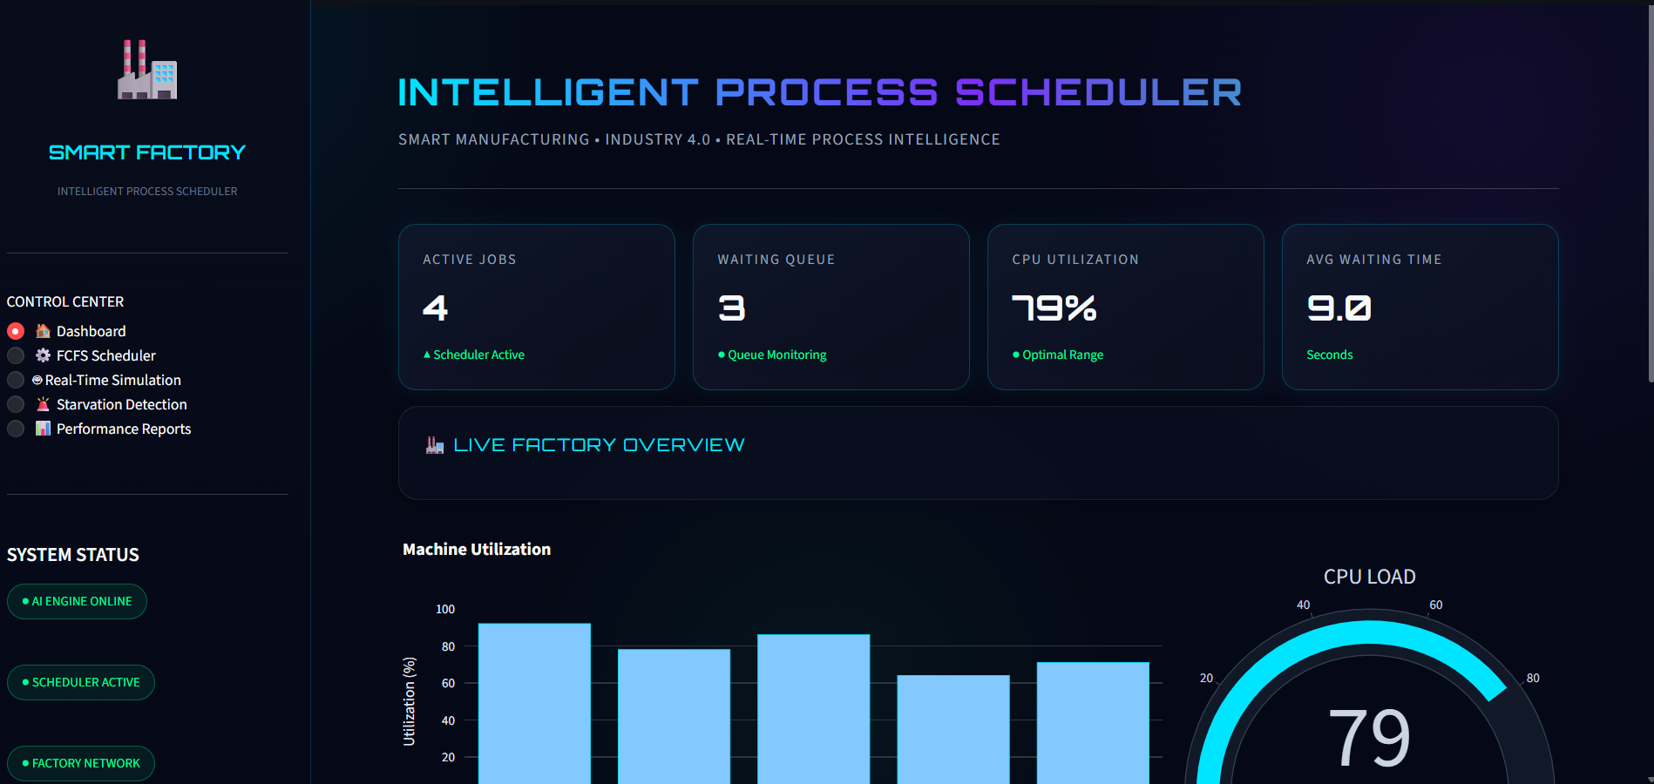
Implementation

Slide 12
Result
Efficient Job Scheduling – Manufacturing jobs are successfully organized and executed using the FCFS scheduling algorithm.
Reduced Scheduling Delays – Waiting and turnaround times are calculated to identify and reduce process delays.
Real-Time Monitoring – Job execution and process status are monitored through the interactive dashboard.
Starvation Detection – Jobs with excessive waiting times are automatically identified and alerted.
Performance Evaluation – Scheduling performance, job completion, and machine utilization are analyzed through reports and graphical results.

Slide 13
Conclusion
The system provides an efficient process scheduling solution for smart manufacturing environments.
FCFS scheduling helps organize manufacturing jobs based on their arrival time.
Real-time simulation and starvation detection improve process monitoring and reduce unnecessary delays.
Performance analysis and report generation help evaluate scheduling efficiency and machine utilization.
Overall, the system improves productivity, monitoring, and decision-making in smart manufacturing systems.

Slide 14
References
Bozzi, A., Graffione, S., Sacile, R., & Zero, E. (2023). Dynamic MPC-based scheduling in a smart manufacturing system problem. IEEE Access. https://doi.org/10.1109/ACCESS.2023.3341504
Paraschos, P. D., Koulinas, G. K., & Koulouriotis, D. E. (2023). Reinforcement learning-based scheduling for flexible and sustainable manufacturing systems. Flexible Services and Manufacturing Journal. https://doi.org/10.1007/s10696-023-09496-9
Gu, W., Li, Y., Liu, S., Yuan, M., & Pei, F. (2023). Data-driven real-time scheduling method of smart workshop. Journal of Mechanical Engineering. https://doi.org/10.3901/JME.2023.12.047
Chorghe, S., Kumar, R., Kulkarni, M. S., Pandhare, V., & Lad, B. K. (2024). Smart scheduling for next generation manufacturing systems: A systematic literature review. Journal of Intelligent Manufacturing. https://doi.org/10.1007/s10845-024-02484-2
Yao, J., Su, R., & Tan, C. (2025). Integrated timetable optimization and AGV dispatching in smart manufacturing. IEEE ITSC Proceedings. https://doi.org/10.1109/ITSC58415.2024.10920047
Tang, L. (2024). Digital-twin-enabled intelligent scheduling for manufacturing systems. Applied Sciences. https://doi.org/10.3390/app14156622
Leet, C., Sciortino, A., & Koenig, S. (2025). An anytime scalable algorithm for smart factory scheduling. arXiv preprint. https://arxiv.org/abs/2510.01770

Slide 15


